Slide 1
Looping Constructs and Arrays

Slide 2
Control Flow Statements.
Decision Making statements
  if statements
  switch statement
Loop statements
  do while loop
  while loop
  for loop
  for-each loop
Jump statements
  break statement
  continue statement

Slide 3
If Statements
Simple if statement
if-else statement
if-else-if ladder
Nested if-statement
public class Student {
public static void main(String[] args) {
int x = 10;
int y = 12;
if(x+y > 20) {
System.out.println("x + y is greater than 20");
}
}
}

Slide 4
Body Mass Index (BMI) is a measure of health on weight. It can be calculated by taking your weight in kilograms and dividing by the square of your height in meters. The interpretation of BMI for people 16 years or older is as follows: Develop a JAVA application to get the weight and height of a person and print appropriate information.

Slide 5
import java.util.Scanner;
public class Example {
public static void main(String args[]) {
Scanner sc = new Scanner(System.in);
System.out.print("Input weight in kilogram: ");
double weight = sc.nextDouble();
System.out.print("\nInput height in meters: ");
double height = sc.nextDouble();
double BMI = weight / (height * height);
System.out.print("\nThe Body Mass Index (BMI) is " + BMI + " kg/m2");
}
}

Slide 6
If-else-if ladder
if (condition-1)
statement 1;
else if (condition)
statement 2;
.
else
statement;

Slide 7
class First {
public static void main(String[] args)
{
// initializing expression
int i = 20;
// condition 1
if (i == 10)
System.out.println("i is 10\n");
// condition 2
else if (i == 15)
System.out.println("i is 15\n");
// condition 3
else if (i == 20)
System.out.println("i is 20\n");
else
System.out.println("i is not present\n");
System.out.println("Outside if-else-if");
}
}

Slide 8
Nested-if
if( condition ){
if( condition ){
if( condition ){
......
}
}
}

Slide 9
class GFG
{
public static void main(String args[])
{
int a=10;
int b=20;
if(a==10)
{
if(b==20)
{
System.out.println(“VIT");
}
System.out.println(“SCOPE”);
}
}
}

Slide 10
Switch statement
switch (expression){
case value1:
statement1;
break;
.
.
.
case valueN:
statementN;
break;
default:
default statement;
}

Slide 11
public class Student {
public static void main(String[] args) {
int num = 2;
switch (num){
case 0:
System.out.println("number is 0");
break;
case 1:
System.out.println("number is 1");
break;
default:
System.out.println(num);
}
}
}

Slide 12
public class SwitchExample {
public static void main(String[] args) {
//Declaring a variable for switch expression
int number=20;
//Switch expression
switch(number){
//Case statements
case 10: System.out.println("10");
break;
case 20: System.out.println("20");
break;
case 30: System.out.println("30");
break;
//Default case statement
default:System.out.println("Not in 10, 20 or 30");
}
}

Slide 13
Java User Input (Scanner)
The Scanner class is used to get user input, and it is found in the java.util package.
To use the Scanner class, create an object of the class and use any of the available methods found in the Scanner class documentation.
In our example, we will use the nextLine() method, which is used to read Strings:
import java.util.Scanner; // Import the Scanner class
class Main {
public static void main(String[] args) {
Scanner myObj = new Scanner(System.in); // Create a Scanner object
System.out.println("Enter username");
String userName = myObj.nextLine(); // Read user input
System.out.println("Username is: " + userName); // Output user input
}
}

Slide 14
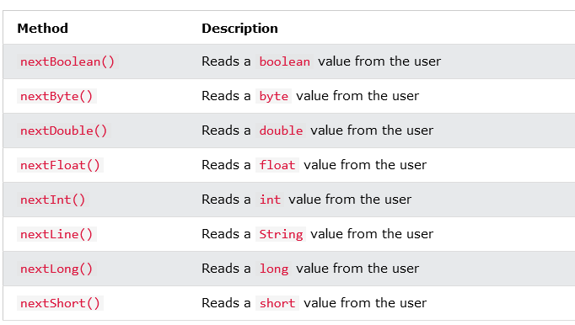
Input Types

Slide 15
import java.util.Scanner;
class Main {
public static void main(String[] args) {
Scanner myObj = new Scanner(System.in);
System.out.println("Enter name, age and salary:");
// String input
String name = myObj.nextLine();
// Numerical input
int age = myObj.nextInt();
double salary = myObj.nextDouble();
// Output input by user
System.out.println("Name: " + name);
System.out.println("Age: " + age);
System.out.println("Salary: " + salary);
}
}

Slide 16
Looping structures in
JAVA

Slide 17
while (condition) {
// code block to be executed
}
int i = 0;
while (i < 5) {
System.out.println(i);
i++;
}
0
1
2
3
4

Slide 18
do {
// code block to be executed
}
while (condition);
int i = 0;
do {
System.out.println(i);
i++;
}
while (i < 5);
0
1
2
3
4

Slide 19
for (statement 1; statement 2; statement 3) {
// code block to be executed
}
for (int i = 0; i < 5; i++) {
System.out.println(i);
}
for (int i = 0; i <= 10; i = i + 2) {
System.out.println(i);
}
0
1
2
3
4
0
2
4
6
8
10

Slide 20
for (int i = 0; i <= 10; i = i + 2) {
System.out.println(i);
If (i==3)
break;
}
for (int i = 0; i < 10; i++) {
if (i == 4) {
continue;
}
System.out.println(i);
}
0
1
2
3
0
1
2
3
5
6
7
8
9

Slide 21
Java For-each Loop
for(data_type variable : array | collection){
//body of for-each loop
}
The Java for-each loop traverses the array or collection until the last element. For each element, it stores the element in the variable and executes the body of the for-each loop.

Slide 22
//An example of Java for-each loop
class ForEachExample1{
public static void main(String args[]){
//declaring an array
int arr[]={12,13,14,44};
//traversing the array with for-each loop
for(int i:arr){
System.out.println(i);
}
}
}
12
13
14
44

Slide 23
class ForEachExample1{
public static void main(String args[]){
int arr[]={12,13,14,44};
int total=0;
for(int i:arr){
total=total+i;
}
System.out.println("Total: "+total);
}
}
Total: 83

Slide 24
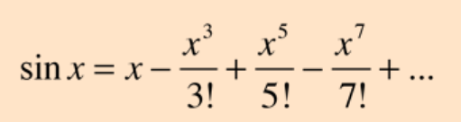
Write a Java program to check whether given year is leap year or not.
Write a Java program to print the given 3-digit number in reverse order.
Write a Java program to verify the given number is palindrome or not.
Write a Java program to display the prime numbers from 50 to 100.
Write a Java program to evaluate the following series:

Slide 25
Write a Java Program to check the given number is armstrong number or not.

